Slide 2
Under Siege: The Looming Cyber Threat Over Main Street The #1 Financial Risk to a Business
Notes:
Our Mission: Be the number one in relentlessly protecting Small to Medium Sized businesses from 99% of cyber-crimes and regulation fines
One of Our Core Values is Knowledge is Power. We believe the best way to accomplish this is to educate those of the cyber threats to their business and promote a unique system and service.
We aim to accomplish this through their most trusted advisors their affiliations with Associations, IMO/FMO’s, and affiliations with adjacent services ie. CPA Firms. This is likely how you ended up here with us today. We are here to educate you on the Cyber Security Secrets for the insurance industry. Your time is valuable, if you make it all the way until the end, we have a special offer for you in exchange for that valuable time.

Slide 3
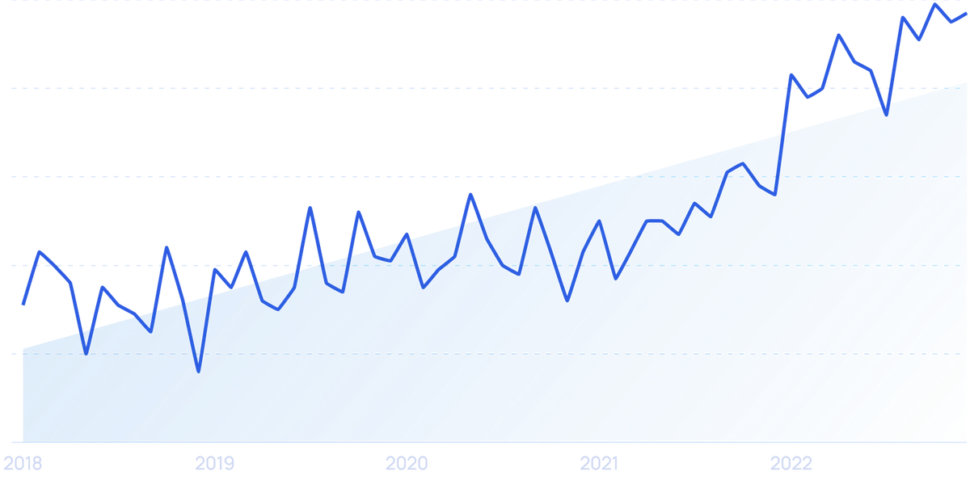
Cyber Attacks are Growing in Intensity
Frequency of Attacks
Total Losses
Notes:
“For many companies the threat in cyber space is still higher than ever,” says Scott Sayce, Group Head of the Cyber Center of Competence.
“The average cost of a data breach reached an all time high, $4.35MM up 50% from $2.2MM in 2021 and could surpass $5MM” – IBM Cost of a Data Breach Report “Small Businesses’ account for 43% of cyber attacks annually” – Accenture CyberCrime Study Costs can be anywhere from $25,000 to $750,000+ depending on how many employees and how regulated your industry is

Slide 4
15+ years building technology to solve business challenges
5 of those now supporting Financial Services, Insurance and Manufacturing Industry
@ CyberFin, responsible for bringing technology and service together to protect businesses
Daniel Metcalf
Managing Partner - CyberFin
Notes:
I have the pleasure of having the greatest position at CyberFin. I get to find the best technology and service in the world to protect businesses while educating business owners.

Slide 5
Agenda:
How did we get here
Anatomy of a Cyber Attack
3 Tips to Protect Your Business
Q&A
Exclusive Offer
Notes:
Our Mission: Be the number one in relentlessly protecting Small to Medium Sized businesses from 99% of cyber-crimes and regulation fines
One of Our Core Values is Knowledge is Power. We believe the best way to accomplish this is to educate those of the cyber threats to their business and promote a unique system and service.
We aim to accomplish this through their most trusted advisors their affiliations with Associations, IMO/FMO’s, and affiliations with adjacent services ie. CPA Firms. This is likely how you ended up here with us today. We are here to educate you on the Cyber Security Secrets for the insurance industry. Your time is valuable, if you make it all the way until the end, we have a special offer for you in exchange for that valuable time.

Slide 6
How did we get here?

Slide 7
Lack in time, resources and knowledge
Security
Productivity
Compliance
Notes:
How did we get here? In an SMB – Who gets attention and funded? Who gets it first?
Virtually all of a company’s daily transactions and all of its key records are created, used, communicated, and stored in electronic form using networked computer technology.
Spend money on more people or equipment to increase your bottom line and increase valuation or spend a portion of it to protect what you already built?

Slide 8
…Tends to Look More Like This
Notes:
“54% admit they are not prepared and their IT lacks the necessary experience” – Austra security audit “However, 47% do not allocate any funds toward cyber security and 51% don’t utilize any basic IT security measures and 17% have cyber insurance” – Austra Security Audit The bad guys know that they can take their cut because business owners like more market share than they do protecting what they have. They’ll just take their cut thank you very much. “76% say the will increase their spending – Astra security audit

Slide 9
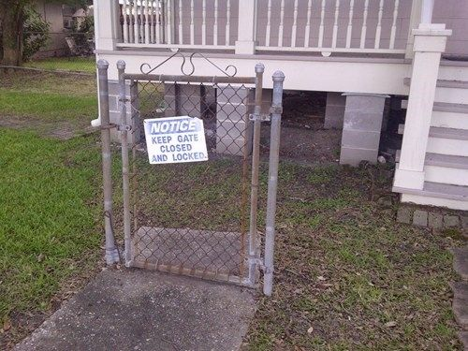
Lack of Security Infrastructure
Notes:
One-third of small businesses depend on free or low-cost cybersecurity solutions meant for individual consumers rather than businesses recommended by internal or outside IT support

Slide 10
Checking the “IT Security” Box
48% of breaches would not have been prevented by Multi-factor authentication
Notes:
In 80% of all hacking cases, compromised credentials or passwords are to blame. 20% of businesses implement multi-factor authentication last year but it quickly proven that it did not slow down the numbers.

Slide 11
Data is the New Gold
Notes:
An overwhelming majority or 87% of small businesses have customer data that could be taken or damaged in an assault. –Astra security audit -data to create false identities for bank account and credit cards – online purchases
-data to build medical profiles for insurance claims
-data to create social engineering attacks on your customers

Slide 12
It’s Where The Money Is
All about the Benjamins
Notes:
One-third of small businesses depend on free or low-cost cybersecurity solutions meant for individual consumers rather than businesses recommended by internal or outside IT support

Slide 13
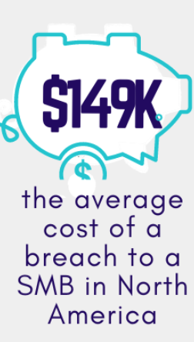
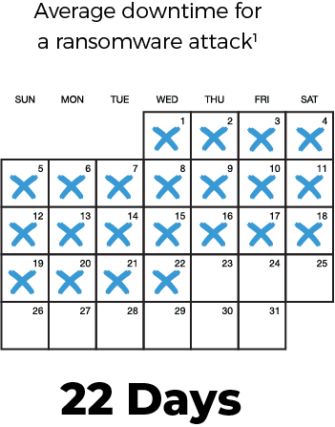
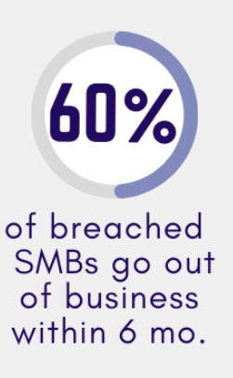
Cyber Crime – The Aftermath
Notes:
I don’t know about you and your clients, but, our couldn’t lose $150,000 or 1 day and not be a candidate for bankruptcy just from the reputation hit alone

Slide 14
How do Criminals Makes Money?

Slide 15
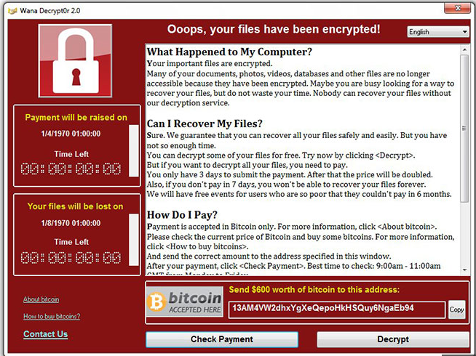
Cyber Extortion
Notes:
Search all your files
Leave a secret door open to come and go as needed (50% of businesses get hit twice)
Download your data and cover their tracks
Destroy your back ups
Launch ransomware to encrypt files/devices/servers
In your system for months

Slide 16
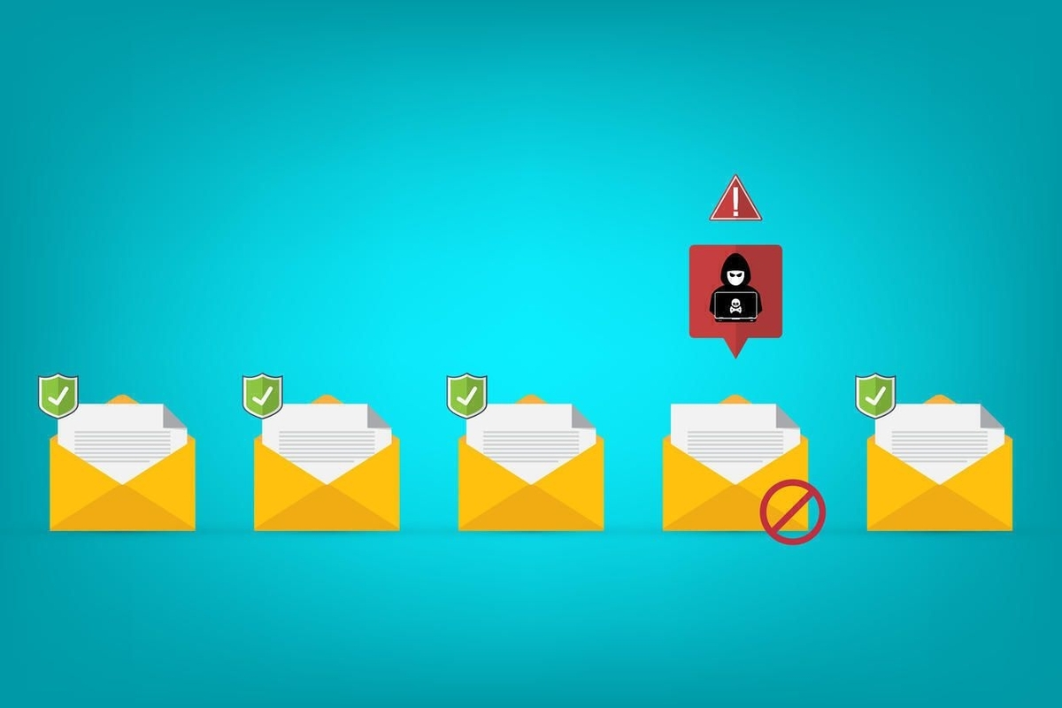
Sell Your Data on the Dark Web
Business E-mail Compromise
Notes:
Data Breach or Theft: The criminal first needs to obtain the customer data. This can happen through various means, including hacking into databases, phishing attacks, malware infections, or purchasing data from other criminals who specialize in data theft.
Data Preparation: Once the data is acquired, the criminal may organize it to maximize its value. This could involve sorting the data by categories such as names, addresses, credit card numbers, social security numbers, birth dates, addresses, titles, social media accounts, and other sensitive information.
Anonymization: To protect their identity and avoid detection, the criminal may attempt to anonymize the data by removing any personally identifiable information (PII) that could trace back to them directly.

Slide 17
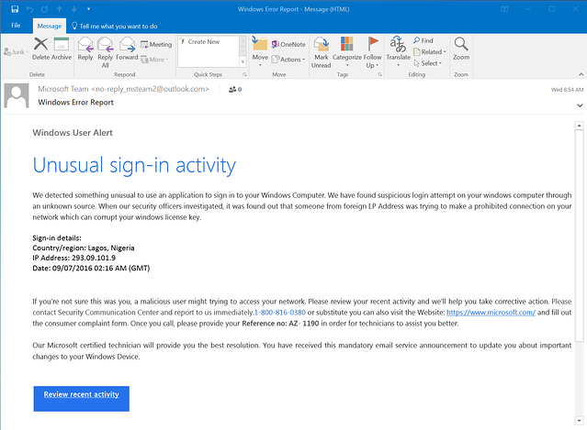
Scary Story – Acquirer Pays $1.2MM
Sitting in the weeds
Malware placed through VPN
Placed encrypted code months earlier and reading e-mails
Additional $1.2MM just to have manufacturer restored.
Notes:
When a cyber criminal targets an insurance company, they know they will have access to social security numbers, financial information, all personal information including addresses and birthdates, and some medical information.
When a private equity firm had acquired a midsized manufacturer late last year, little did they know that someone else had set on the same target as well. Just two months after it was purchased, a cybercriminal organization launched a crippling ransomware attack that locked up the manufacturer’s systems. The acquirer eventually paid $1.2 million to have their systems released, a risk they did not account for during the M&A process.

Slide 18
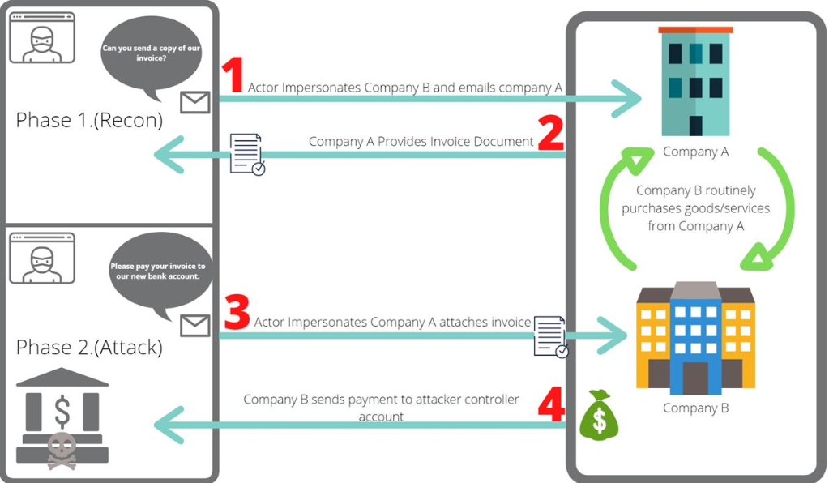
Invoice Manipulation
Business E-mail Compromise
Notes:
Two Types:
Supplier impersonator – Masquerades as a legitimate Supplier
Supplier Compromiser - a malicious actor has gained unauthorized access to an email account at a supplier likely through a phishing campaign or purchased stolen credentials. The threat actor may even hijack an existing email thread of a compromised account. The threat actor then uses this access to observe, mimic, and utilize historical conversations to craft believable messages with supporting documents. Since the threat actor’s messages end up as part of an email thread that is already in progress, the victim is much more likely to believe in their legitimacy, and the threat actor has a greater chance of success.
In fact, attacks such as these can be some of the most convincing a user will ever face.

Slide 19
“Muling” Access to Bigger Phish
Supply Chain Attacks
Notes:
Leveraging Trust Relationship: Use the compromised access to send malicious emails or messages to the larger enterprise, pretending to be the smaller business. Alternatively, they might insert malware or backdoors into products or services provided by the smaller business to the larger one.
Expanding the Attack: With access to the larger enterprise's network or systems, the cybercriminals can then move laterally, escalating their privileges and accessing sensitive data or systems within the larger organization. This could lead to data theft, financial fraud, or other malicious activities.
Covering Tracks: To avoid detection, cybercriminals may cover their tracks by deleting logs, masking their activities, or using encryption and anonymization techniques.

Slide 20
The Anatomy of an Attack

Slide 21
Reconnaissance
Social Engineering
Notes:
Spear-phishing is a targeted attempt to steal sensitive information such as account credentials or financial information from a specific victim, often for malicious reasons. Image from Linkedin

Slide 22
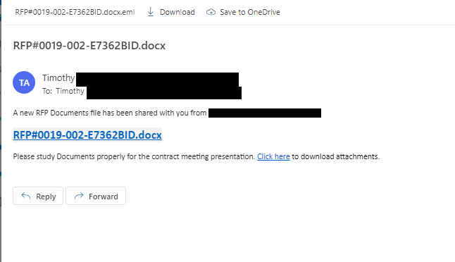
Reconnaissance
Spear Phishing
Notes:
Spear-phishing is a targeted attempt to steal sensitive information such as account credentials or financial information from a specific victim, often for malicious reasons.

Slide 23
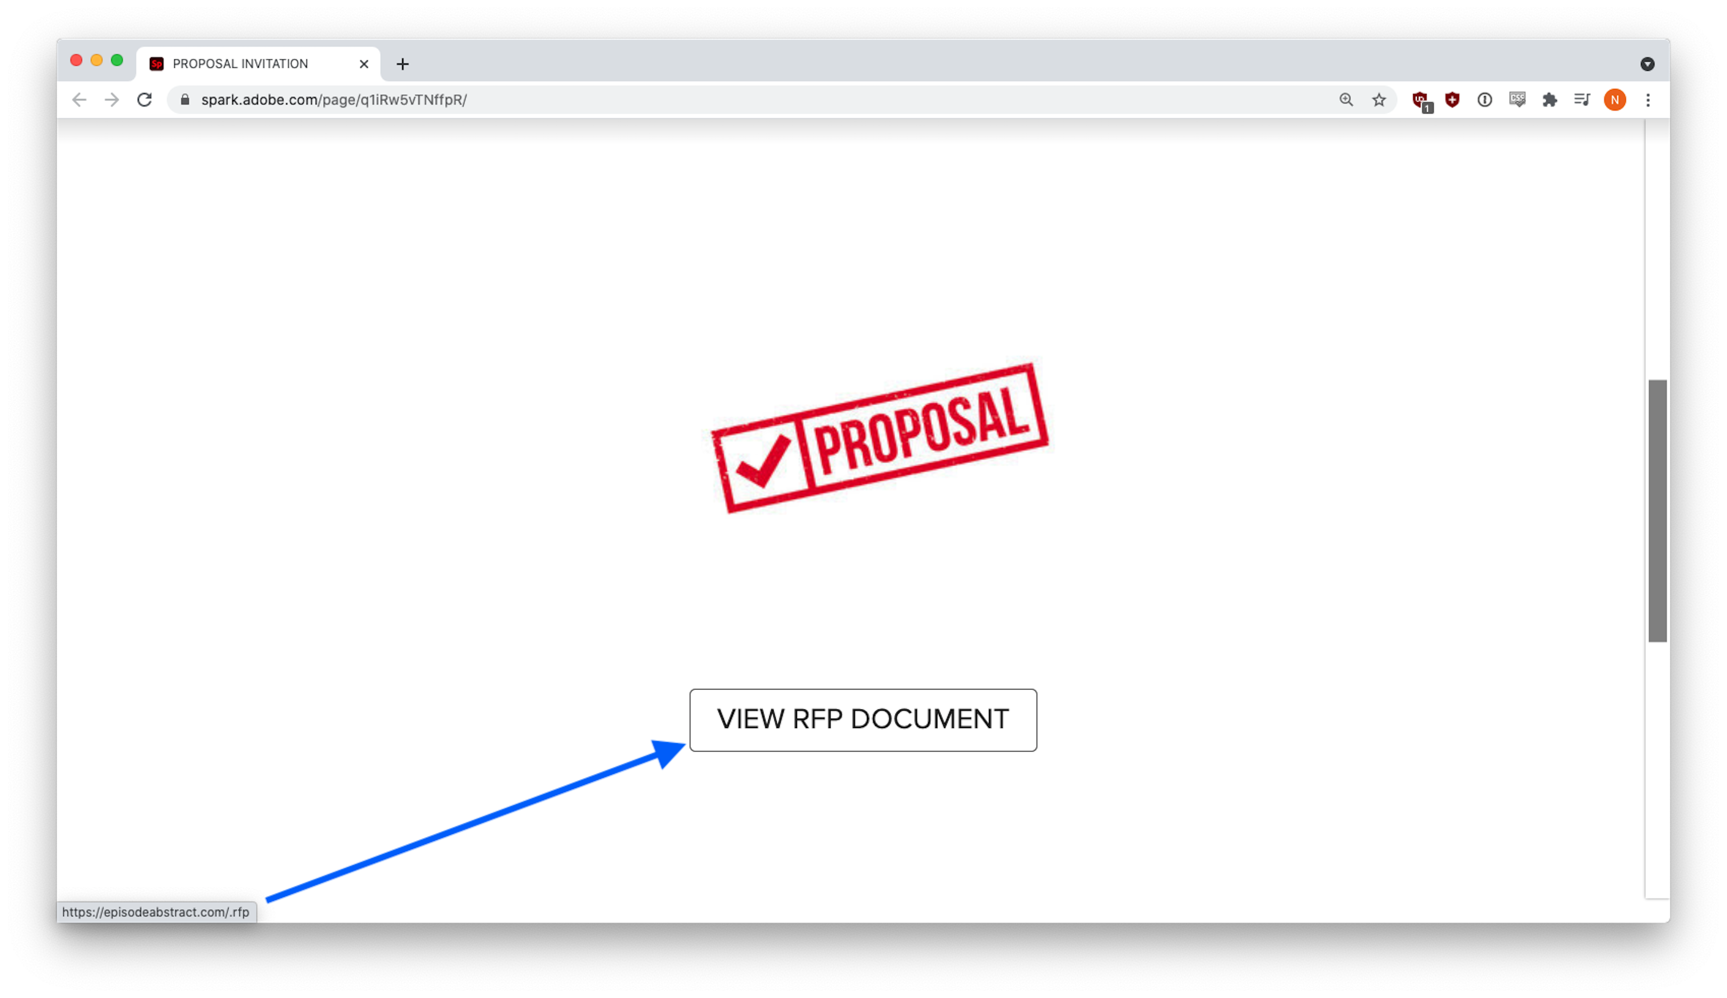
Typo squatting
The Trick
Notes:
It turns out, episodeabstract[.]com was a recently created domain controlled by the phisher.

Slide 24
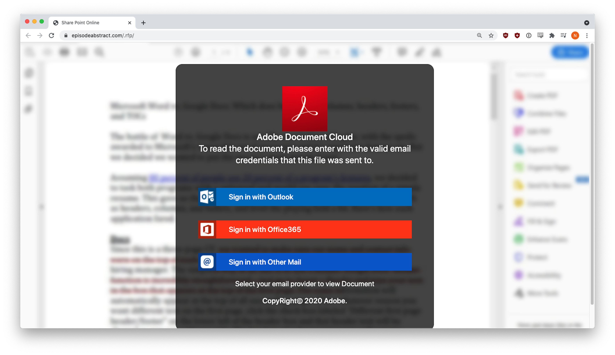
Credential Harvesting Form
Notes:
Three different credential harvesting forms appeared, depending on the email provider selected.

Slide 25
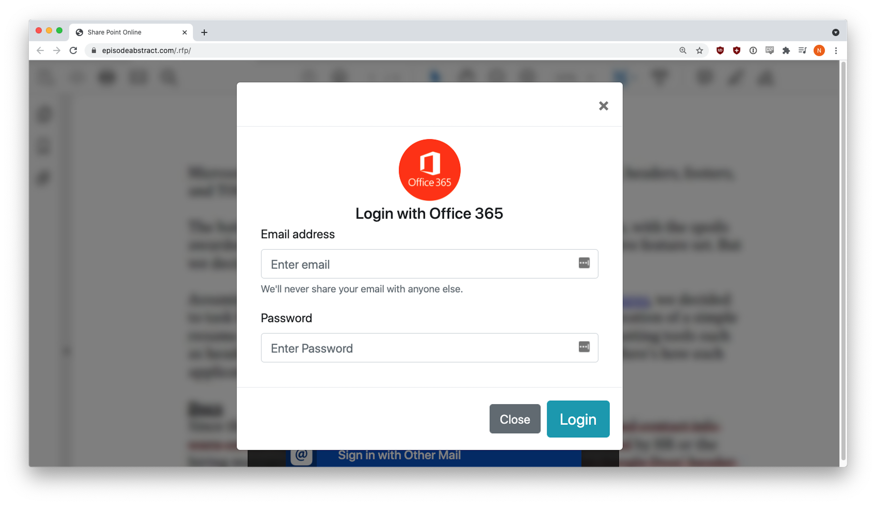
Credential Harvesting Form
Notes:
but behind the scenes, that data had already been sent to the phisher. This tactic is fairly common. The victim sees an error message, but the form captures their input anyway.

Slide 26
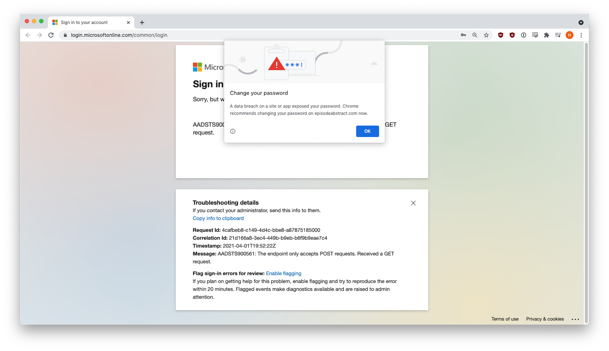
Real Microsoft Account
Notes:
Phishers are nothing if not clever and resourceful. They get an error message but behind the scenes, that data had already been sent to the phisher. This tactic is fairly common. The victim sees an error message, but the form captures their input anyway.

Slide 27
Credential Harvesting Form
The Trick
Notes:
Now the attacker tries to get a second set of credentials

Slide 28
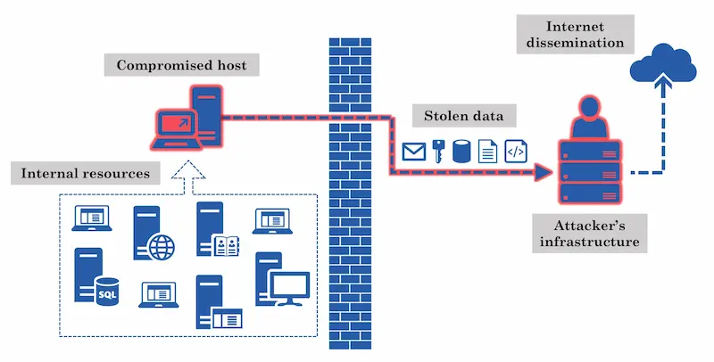
Attacker’s Infrastructure
Exfiltration Of Data
Notes:
If It isn’t to actively destroy your network in ransomware, it is to get your data out of your network and back to the attackers. So the next step is to send that data back to them. Your data will be sent via one or more anonymizing routers throughout the Internet so that you can’t track where the data is going. Image from “mindpoint group”

Slide 29
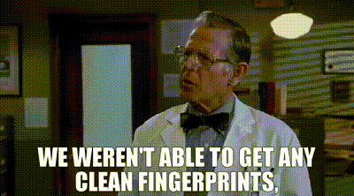
No visible tracks and leave a back door
Sanitation
Notes:
The attackers will remove all evidence that they were in your network and systems. This is to make a clean getaway but also allowing them to come back in next week, month, or year and attack you again.

Slide 30
Cyber Security Tips

Slide 31
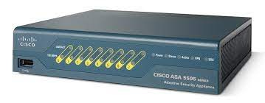
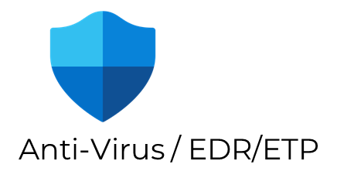
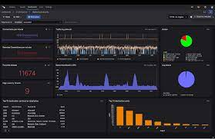
The Old Guard
President
Firewall
GAP
Internal IT
GAP
Cloud Services
GAP
GAP
GAP
GAP
Field Staff
Office Staff
GAP
Servers
GAP
GAP 4x
Floor Staff
GAP
Outside IT
Alert Dashboard – 4X
Notes:
This infrastructure the bad guys are looking for Retail grade IT security software that doesn’t talk to each other
Only works if everyone is in the castle
Increased attack surface
No one watching 24x7

Slide 32
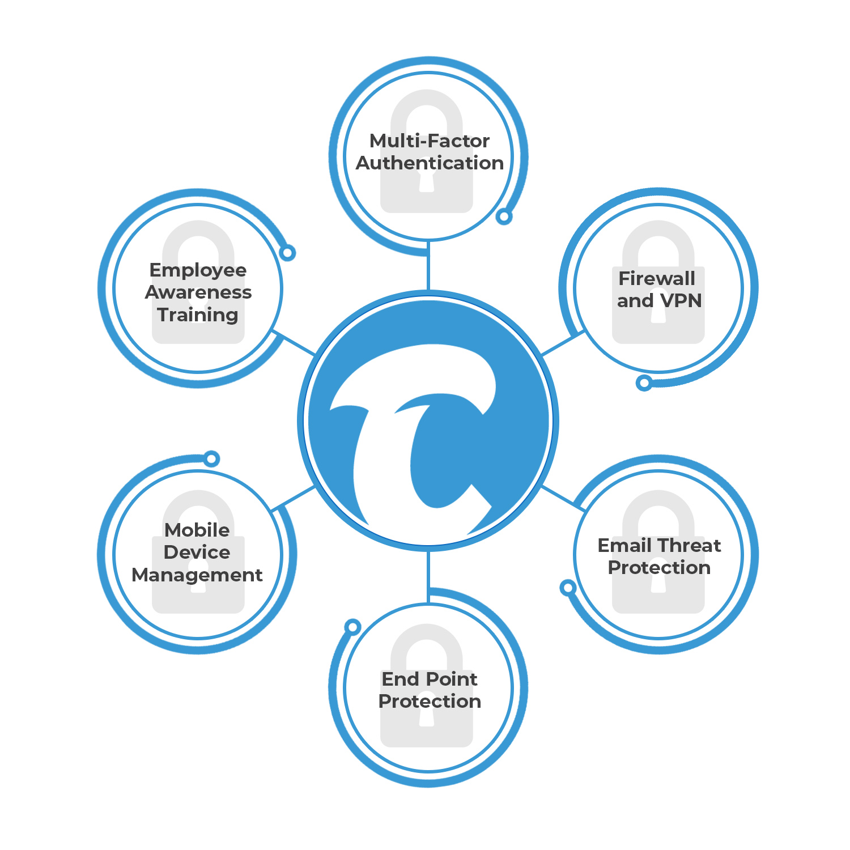
Simple, Relentless and Complete Cyber Security
Eliminate the gaps in your cyber security
A multi-layered user-based security approach
All-in-one cyber security management software plus 24x7 SOC & SIEM plus threat hunting
Zero-Cost Remediation

Slide 33
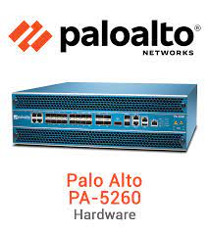
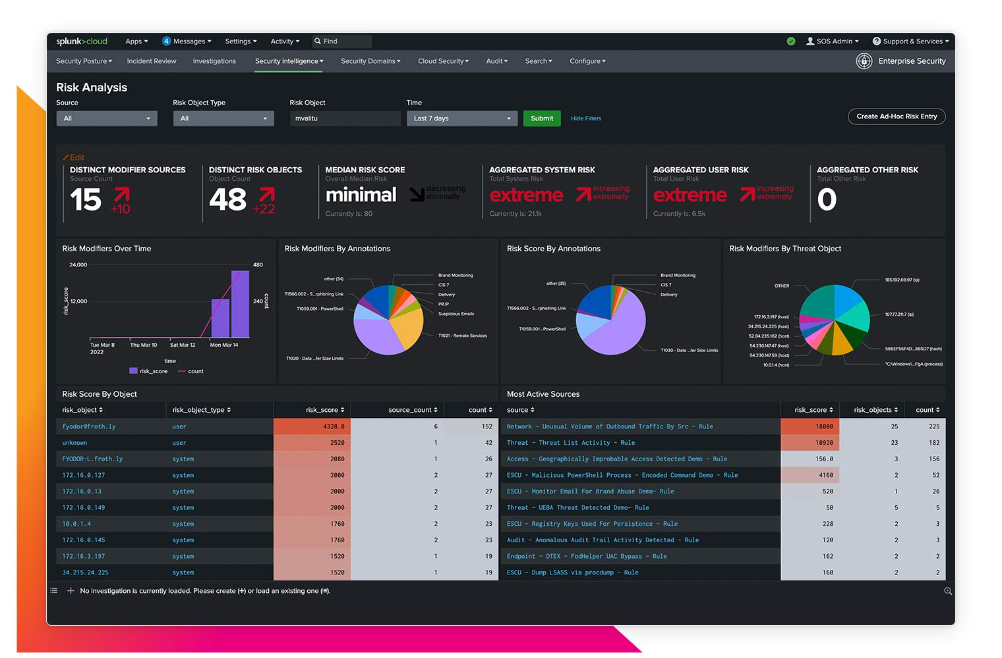
The New Guard Managed Layered Security by User
Security Operations Center (SOC)
President
Internal IT
Outside IT
Security Information & Event Management (SIEM)
On Premise/Cloud Servers
Office Staff
Field Staff
24 x 7 x 365

Slide 34
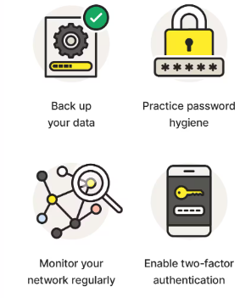
Tip #1 – Don’t underestimate cyber criminals
FACT –Looking less attractive to criminals lowers their R.O.I.
Password lengths, complexity and two factor slow the bad guy down to maybe move on
Off-domain back ups create the ability to recover data quickly reducing extortion demands
Monitor your network regularly for updates and patches closes outside vulnerabilities
Notes:
Remember – you are a user too

Slide 35
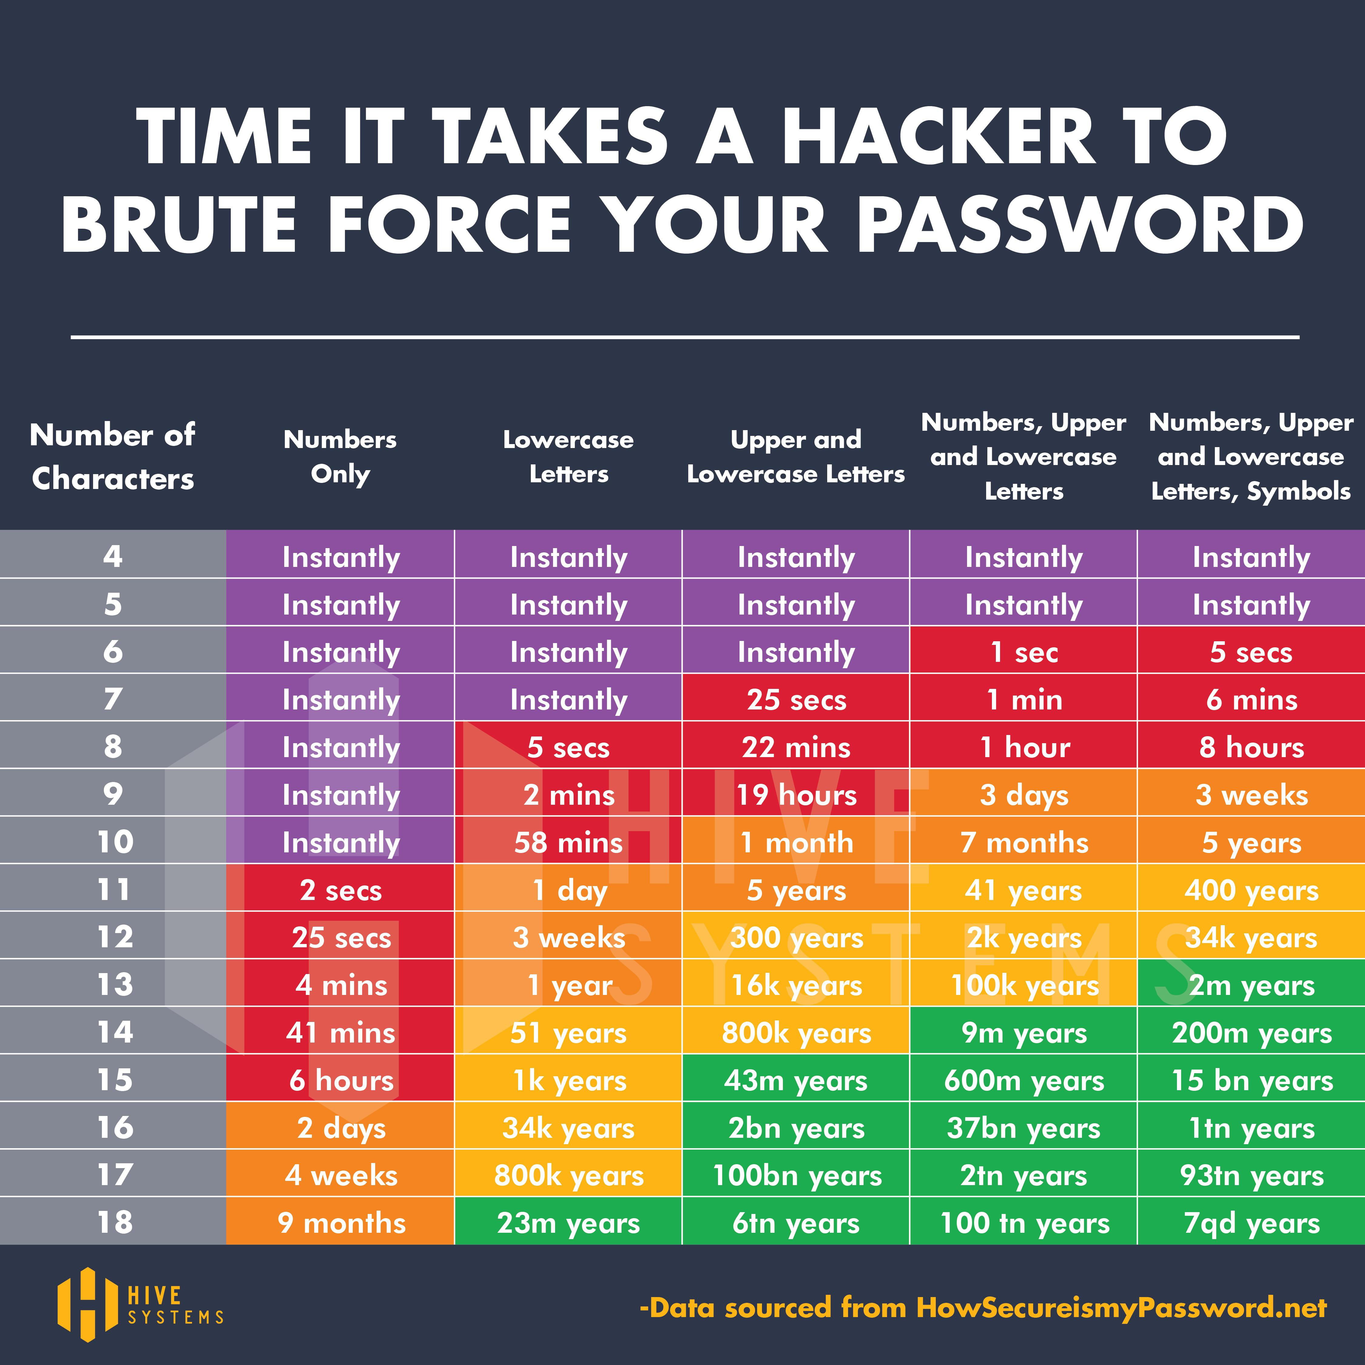
Create and require complex passwords
With Multi-Factor Authentication
14+ characters
Numbers, Upper and Lower Case
Add Two Factor to e-mail, cloud and remote access
Notes:
Remember – you are a user too

Slide 36
Tip #2 – Separate business & personal
FACT – Bad guys are looking for hybrid users vulnerabilities more than in office
Business only devices both in the office and out of it
Home office security as an extension of the field office lowers the attack surface in both places
Business only e-mail boxes and log-ins eliminates known vulnerabilities of free products and allows for security software install – eliminate @gmail, @yahoo, @outlook, @live, @aol, @myspace addresses
Notes:
Remember – you are a user too

Slide 37
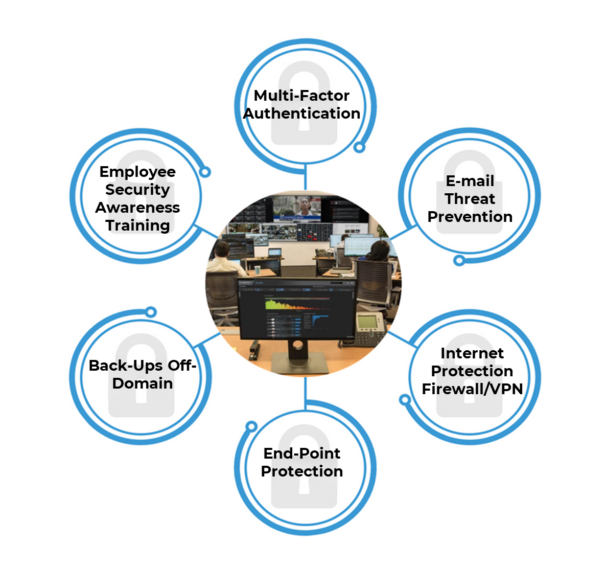
Tip #3 – Mind the Gaps
FACT –A layered security approach by end user lowers your attack surface
Prevents all kind of attacks not just external attacks
Protects your cloud/virtual environment by treating it like a on-premise environment
Trusts No One inside your organization with security protocols inside the company too
24 x 7 monitoring and remediation reduces the time and impact of an attack
Notes:
Remember – you are a user too

Slide 38
Questions?

Slide 39
Exclusive Offer

Slide 40
This is available to all sized businesses
For half of a cell phone bill per month

Slide 41
CyberFin – Getting Started
Our Survey and Risk Assessment to identify the gaps in Cyber Security
Custom Solution for your Company
1 hour for the owner and 15 minutes per user
Following installation, your company has layered protection and a team actively managing it

Slide 42
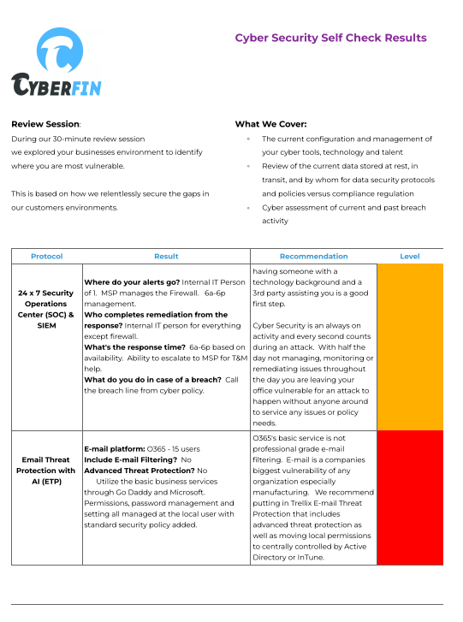
Cyber Security Assessment
Cyber Security Audit
FREE + No Obligation ($499 value)
Go to: Cyberfin.net/cyber-self-check
Notes:
Schedule your no obligation cyber self check

Slide 43
Exclusive Offer: Relentless Cyber Protection $59/user (35% off)
24 x 7 SOC/SIEM
Notes:
Remember – you are a user too

Slide 44
Next Steps
Schedule a no obligation CYBERFIN.NET/CYBER-SELF-CHECK or e-mail protectme@cyberfin.net
Close the gaps identified during cyber security assessment
Receive Peace of Mind by protecting yourself and clients from the financial burden of cyber crimes and regulation fines
Powered by:
Notes:
https://cyberfin.net/cyber-self-check

Slide 45
Thank You
Daniel Metcalf – Co-Founder
e: dm@cyberfin.net
d: 612-400-9545
w: www.cyberfin.net
Powered by:

Slide 46
How CyberFin Severely Lowers Cyber Crimes or Compliance Fines

Slide 47
Layer: Advanced E-mail Filtering

Slide 48
Layer: Secure Internet Portal AOVPN
All internet traffic flows through our servers for web content filtering

Slide 49
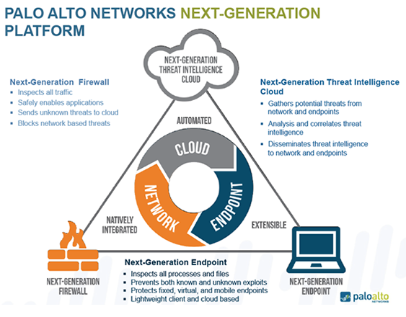
Layer: XDR End Point Protection
Anomalies from inside set off alerts and Remediation of Threat is completed

Slide 50
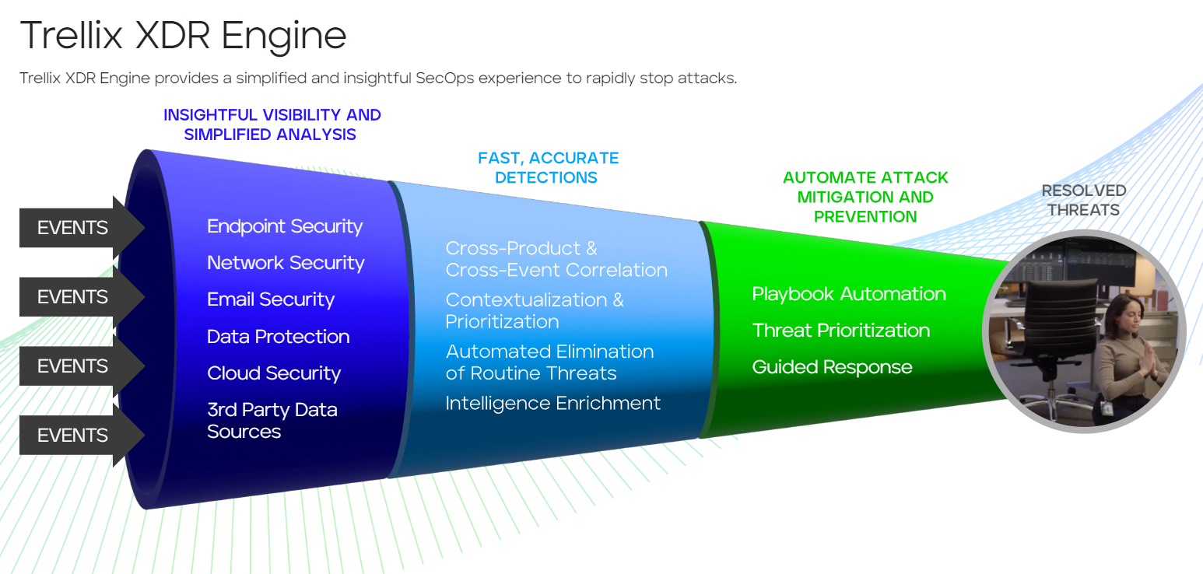
Layer: XDR End Point Protection
Anomalies from inside set off alerts and Remediation of Threat is completed

Slide 51
24 x 7 SOC & SIEM + Threat Hunting
Security Operations Center
Security Information and Event Management

Slide 52
RISK Severely Lowered
Fully managed to eliminate the gaps in time and lack of expertise 24 x 7
Layered security software of internet, e-mail and device protection for each user lowers attack surface
Look less attractive to criminals and regulators with policies, incident response, data encryption and off-domain back ups

Slide 53
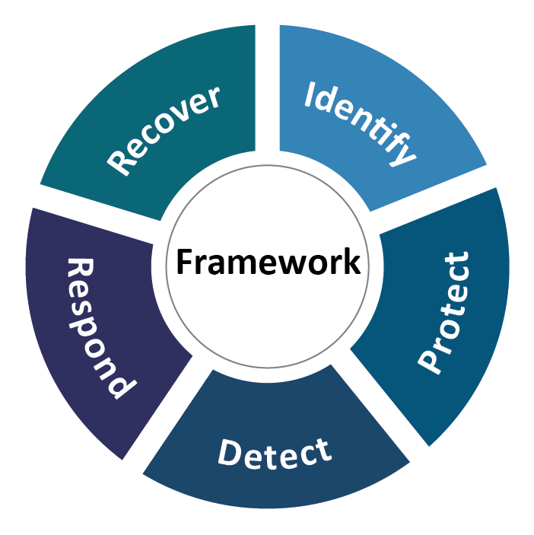
Relentless Cyber Compliance Guidance
Employee Awareness Training
Written Information Security Policy
Encrypted Outbound E-mail
Encrypted back-up off domain
Incident Reporting
Employee and Customer Credit Restoration
vCISO Services
Risk Management
Vendor Risk Management
3rd Party Scans (Penetration Testing and Vulnerability Testing)
Powered by:
NIST FRAMEWORK
Notes:
Each form of compliance comes in different forms depending on the agency beyond just the simple 2 for large organizations.
CyberFin Offers services above and beyond for larger organizations

Slide 54
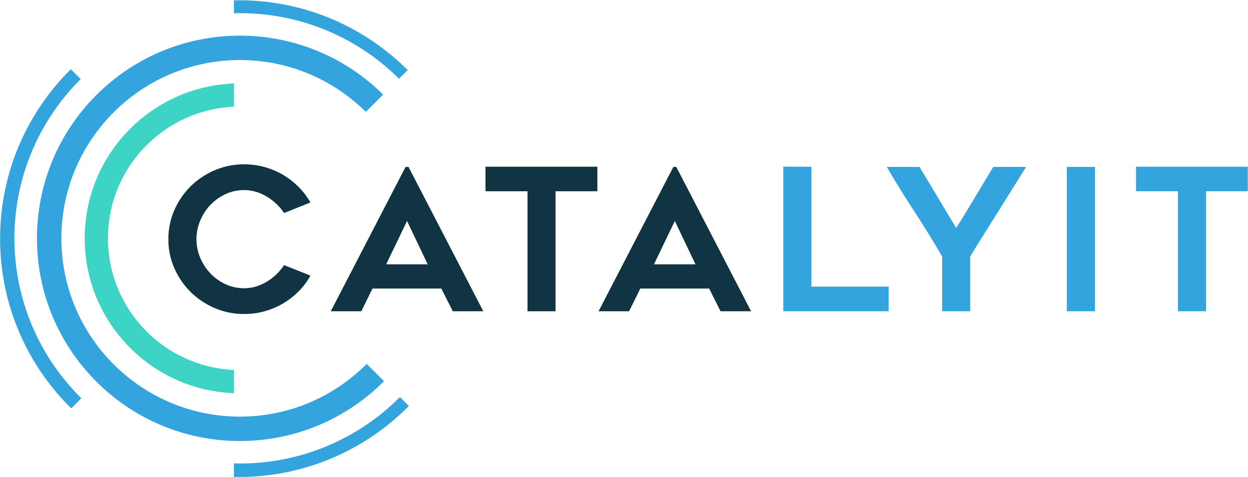
Endorsements
Powered by:
Notes:
Our Partners

Slide 55
What our customers say…
Powered by:
Notes:
Our Partners

Slide 56
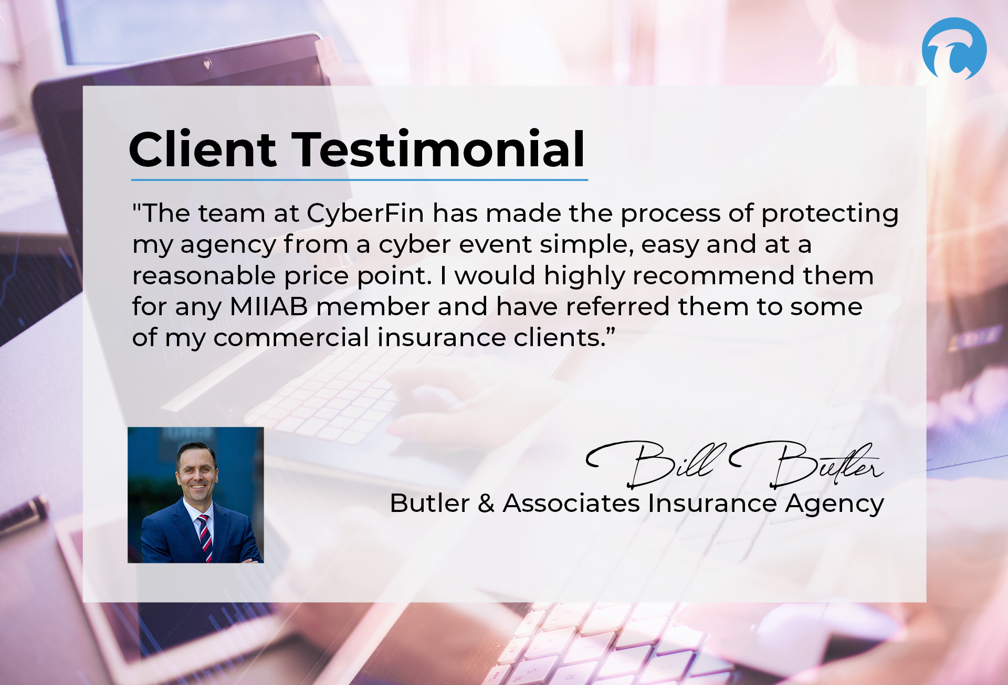
What our customers say…
Powered by:
Notes:
Our Partners

Slide 57
What our customers say…
Powered by:
Notes:
Our Partners

Slide 58
What our customers say…
Powered by:
Notes:
Our Partners

